Slide 1

PHISHING AWARENESS
Building a Human Firewall Against Social Engineering Threats
PREPARED BY:
Khaled ElSayed ElSayed

Slide 2




What is Phishing?
The Threat Vector
Psychological Vulnerability
Phishing is a highly deceptive cybersecurity exploit where bad actors masquerade as trusted entities (banks, administrators, service providers) to deceive targets.
Attackers do not rely solely on technical exploits; they actively weaponize behavioral psychology. They exploit common triggers to bypass analytical thinking:
The primary goal is tricking users into sharing critical credentials, releasing confidential assets, or unknowingly deploying malicious payloads.
Urgency: Fictional deadlines trigger reactive panic.
Fear: Account closure threats bypass logic.
Authority: Mimicking executive presence forces compliance.

Slide 3

Anatomy of a Phishing Email
From: IT Support Team <security-update-verification@web-domain-verify.com> To: user@university.edu Subject: URGENT: Immediately Verify Account Credentials
Key Detection Indicators
Even advanced spoofing contains noticeable errors. Look closer at this simulated mail:
Dear Valued User, We have detected unusual sign-in activity on your internal account. To avoid complete account suspension, please verify your profile using the link below within 24 hours: ACTIVATE SECURITY PROFILE NOW Kind Regards, Organizational Helpdesk System
Unrecognized Sender: The display text says "IT Support" but the actual email domain is an unverified outside URL.
Fear Tactics: Forcing instant reaction by warning of immediate account suspension.
Vague Greetings: Addressed to "Dear Valued User" instead of your actual profile name.

Slide 4





Common Attack Vectors
Spear Phishing
Smishing (SMS)
Vishing (Voice)
Highly customized, laser-targeted attacks. Bad actors scour public profiles (like LinkedIn) to extract context, names, and projects, designing a narrative that feels authentically local.
Attacks delivered via mobile text. Often mimics urgent delivery updates, unpaid tolls, or banking authorization errors. People react faster to SMS threats, making smishing highly effective.
Phishing via standard telephone paths. Attackers mimic authority bodies (helpdesk, fraud department, tax agency), utilizing caller ID spoofing and AI voice-cloning to manipulate targets.

Slide 5
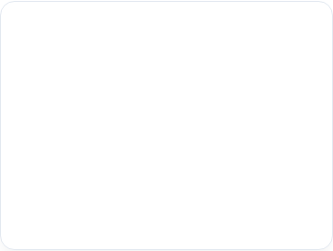

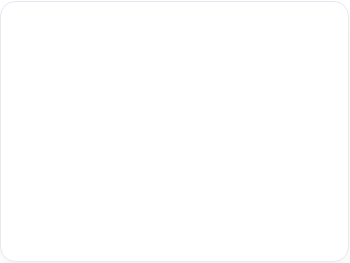



Case Study: The $40M BEC Attack
Business Email Compromise (BEC) uses social engineering rather than active malware to trigger massive financial wire transfers.
Reconnaissance
Impersonation
Exploitation
Threat actors mapped the corporate organizational tree. They studied accounting processes and identified targeted high-level personnel.
An attacker registered a domain one character off from the legitimate company domain, spoofing an urgent financial request from the CEO.
Trusting the look-alike address and CEO signature, accounting initiated multiple wire transfers, resulting in $40M lost before discovery.

Slide 6


Detection Checklist
Sender Check
Destination Review
Look past the visible name. Click or tap on the sender email header. Check if the domain name precisely matches corporate naming rules.
Hover your cursor over embedded link buttons without clicking. Check the target web path in the preview window at the bottom of your screen.
Tone Alert
File Inspection
Is the sender demanding immediate, non-standard actions? High-stress conditions are used intentionally to prevent you from calling to verify.
Never open attachments requiring macro permissions. Verify unexpected invoices or payroll documents through secondary channels first.

Slide 7


Deceptive Domain Tricks
Official Domain
Typosquatted Domain
portal.university.edu/login
portal-university-edu.com/login
Authentically owned by the official institution.
Hyphens replace subdomains to fool users.
Follows precise sub-domain tree structure.
Root domain is registered on public generic spaces.
Connected directly to primary systems.
Hosted on external servers to steal tokens.

Slide 8



Defense-in-Depth Strategy
MFA Protection
Out-of-Band Check
Reporting Plugin
Enforce Multi-Factor Authentication everywhere. Even if bad actors capture your password, modern physical keys or app authentication push tokens can block unauthorized account access.
Validate suspicious requests through a secondary channel. Contact the sender using their official office directory number rather than using the phone numbers listed inside the suspicious email.
Use your mail client's "Report Phishing" button. This sends raw header data to safety engineers, helping update spam filters globally to block active threats across the institution.

Slide 9
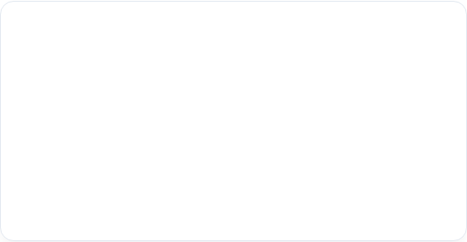
Scenario-Based Practice
Case A: Late-Night HR Alert
Case B: Shipping Alert
At 11:30 PM, you receive an email from "HR Department" saying your benefits document requires signature by morning or payroll will halt. It points to a custom sign-in link.
An SMS notification states: "Your parcel is suspended due to an incorrect home address. Pay an administrative adjustment fee of $1.50 at postal-address-verify.com."
Action: Do not click. HR departments do not set critical deadlines at midnight or threaten payroll holds without warning.
Action: Delete immediately. Standard parcel companies do not send SMS warnings or charge address update fees online.

Slide 10



Interactive Challenge
Log in immediately to claim the card.
Knowledge Check
You receive an email declaring you won an internal service award. To secure the gift card, you are asked to click a link and log in with your institutional credentials. What is the correct response?
Do not click. Report via the phishing system.
Correct Response: B
Official systems never require secondary credentials to access internal rewards or awards.

Slide 11
YOU ARE THE HUMAN FIREWALL
Think Before You Click. Stay Alert. Report Suspicious Activity.
PREPARED BY:
Khaled ElSayed ElSayed

